Slide 1

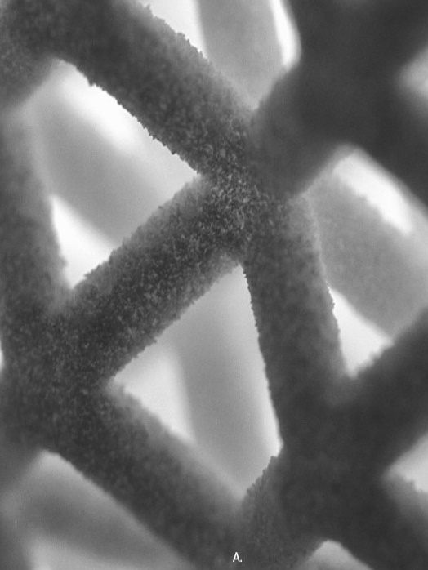
Implicit Modelling in 3MF
2024/02/01

Slide 2
Outline
Brief description of volumetric spec
Separation in two specs/namespaces
Class diagram, overview, channels/volumedata elements (e.g boundary, color, properties…)
Split up class diagram up (e.g. namespaces)
Explain concept of functions
functionfromimage3d (brief)
Example volume
variables and nodes
Private extension
Example implicit, Producer <-> Consumer example

Slide 3
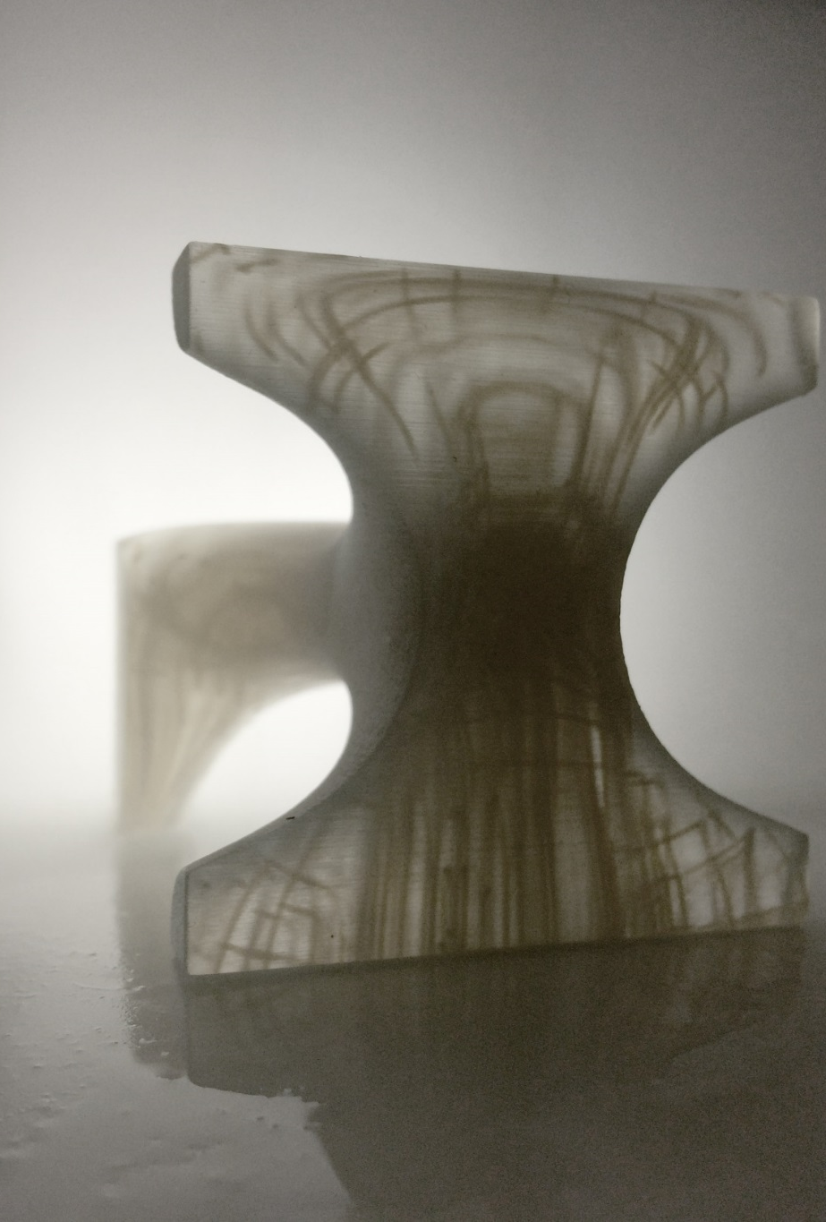
Volumetric extension - concept
& Implicit modelling
Enrich geometry of 3MF with volumetric elements that can represent spatially varying properties.
Inefficient to handle with a mesh representation, especially in cases where the variation is continuous in space or objects are highly complex. => Encode complex objects by explicitly specifying their properties at any point in space. => Use a 3D Texture or mathematical expressions => Provide comprehensive set of volumetric modelling functions => allow extensions to add custom or proprietary functions

Slide 4
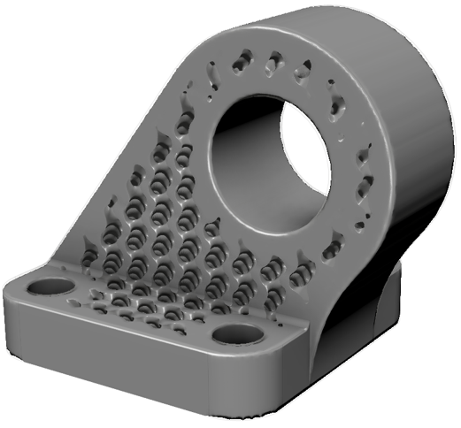
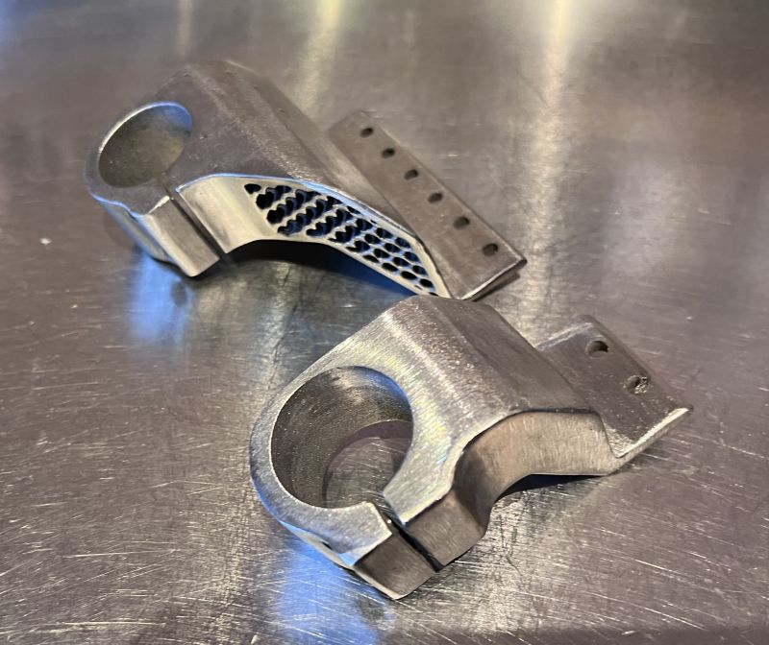
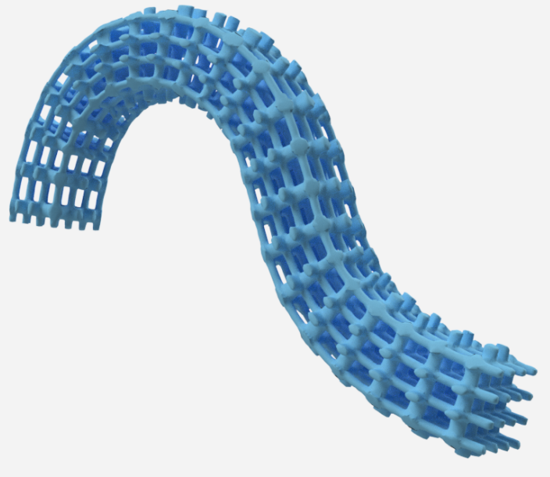
Geometry

Slide 5
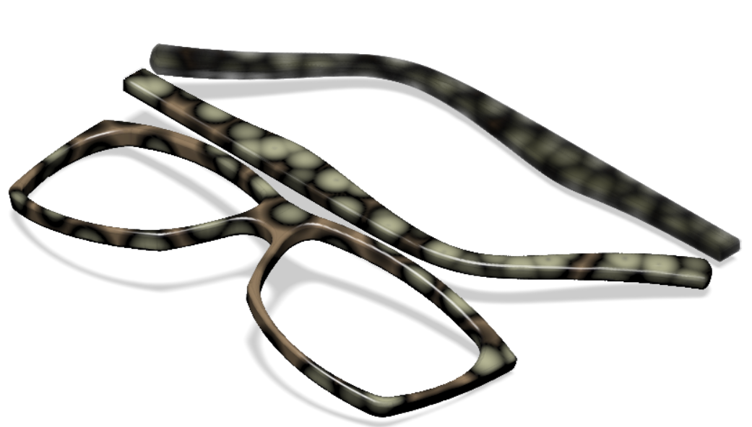
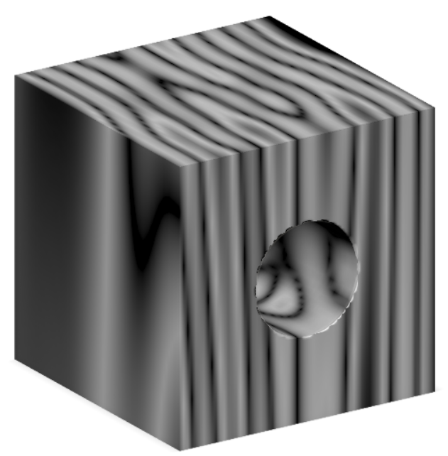
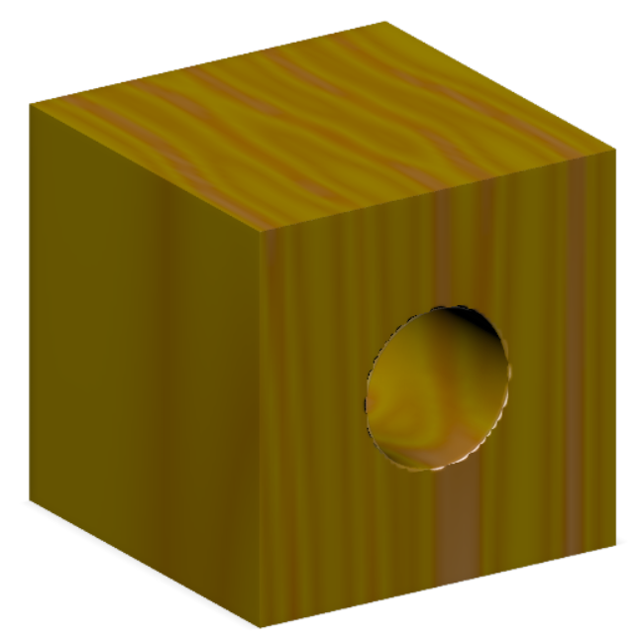
Colors and Properties

Slide 6
2. Implicit Specification

Slide 7
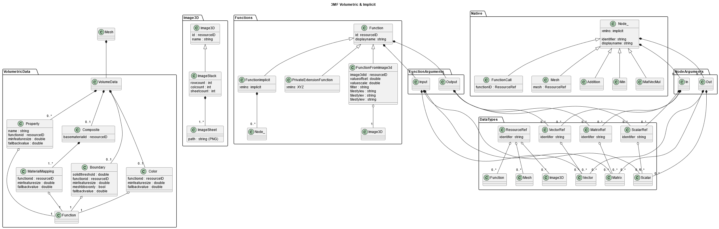
Class Overview

Slide 8
Class Overview: Volumetric namespace
Shape?
xmls:core
xmls:implicit
xmls:volumetric
xmls: privateNamespace

Slide 9
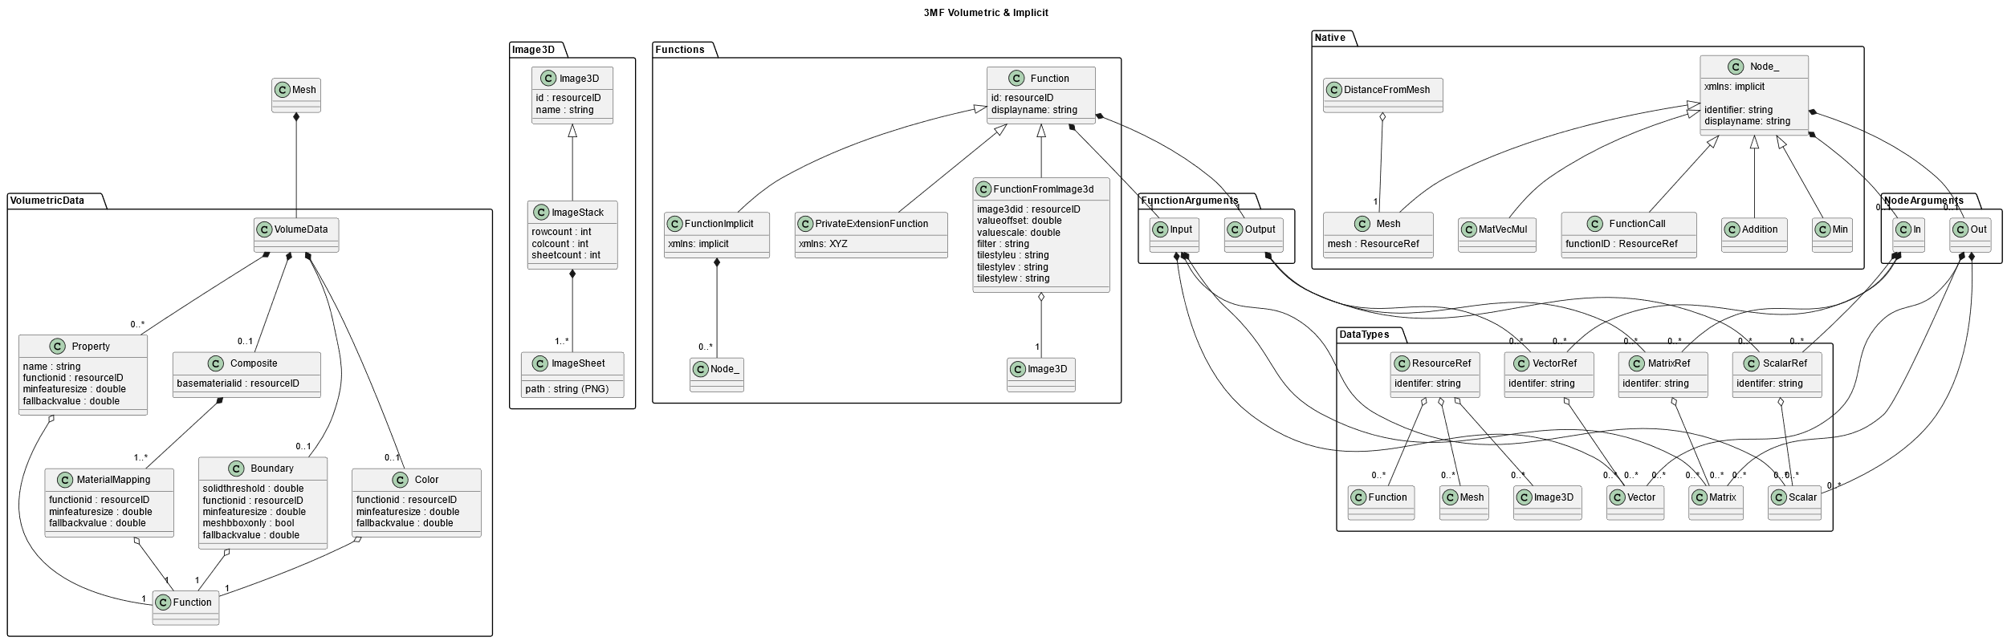
VolumeData
xmls:volumetric
Defines how function values are mapped to the model
Boundary
Levelset
Property
User defined
Color
RGB, Alpha and Opacity to be handled separately (e.g. as Property or Composite)
Composite
Mixing ratios of different materials

Slide 10
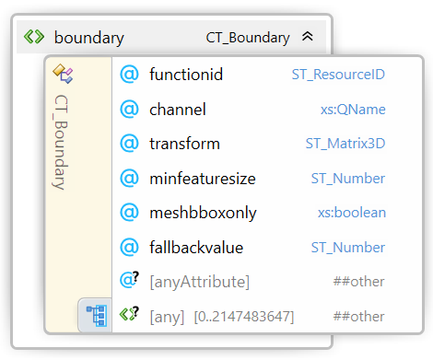
VolumeData Boundary
xmls:volumetric
Functions are referenced by functionid
Function must take a vector pos as input and output a scalar with the name given by channel
channel defines the name of the function output
Optional minfeaturesize as hint for the consumer
Optional fallbackvalue for handling nan

Slide 11
Minimum Feature Size
Minimum Feature Size
Hint for the consumer, may use half of minimum feature size as grid size to retain all relevant features
Separate hint for each VolumeData-Element

Slide 12
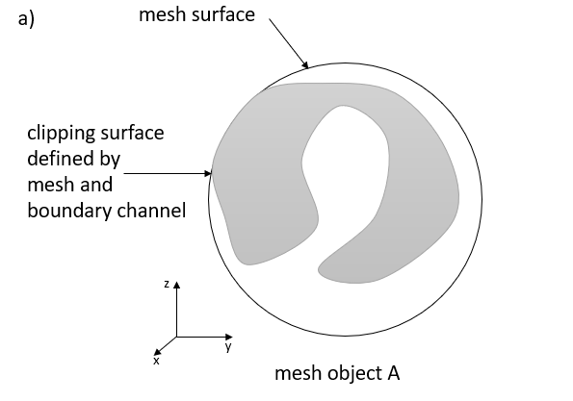
Volumetric data is embedded in 3MF’s scene
Volumetric data is bounded by a mesh-object
Mesh clips implicit description => hybrid model
Mesh does not touch implicit surface => mesh simply indicates where to evaluate the implicit model

Slide 13
meshbboxonly
If set to true, the boundary is not intersected with the mesh itself, but with the bounding box of the mesh
Allows faster evaluation of pure implicit models

Slide 14
How can functions be defined?
xmls:volumetric
xmls:implicit
xmls: privateNamespace

Slide 15
Datatypes for function outputs
xmls:volumetric
Used for RGB colors

Slide 16
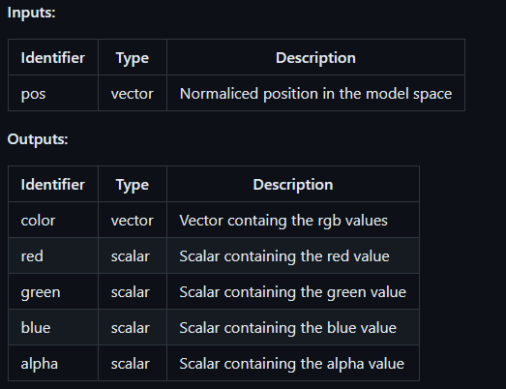
functionFromImage3D
xmls:volumetric
Replaces ScalarFieldFromImage3D and VectorFieldFromImage3D
Predefined Inputs and Outputs
“channel”-Attribute to define the mapping
<v:image3d id="2">
<v:imagestack rowcount="821" columncount="819" sheetcount="11">
<v:imagesheet path="/volume/layer_01.png"/>
...
</v:imagestack>
</v:image3d>
<v:functionfromimage3d id="3" displayname="function from image3d" image3dID="2" offset="0" scale="1400" tilestyleu="wrap" tilestylev="clamp" tilestylew="mirror" filter="linear"></v:functionfromimage3d>
...
<mesh>
<vertices>
...
</vertices>
<triangles>
...
</triangles>
<v:volumedata>
<v:property name="Temp" transform="0.01 0 0 0 0.01 0 0 0 0.01 0.5 0.5 0.5" functionid="3" channel="red"/>
</v:volumedata>
</mesh>

Slide 17
PrivateExtensionFunctions
PrivateExtensionFunctions can be added in their own namespace
For features that can not be expressed in closed form or require proprietary IP
Outputs and Inputs must use the Datatypes Scalar, Vector or Matrix
E.g. iterative Functions, Labels

Slide 18
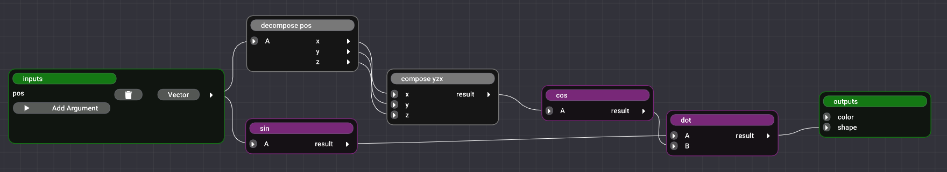
FunctionImplicit
xmls:implicit
Mathematical expression are described as a directed acyclic graph. Inputs to node reference node outputs.
Node Inputs are referencing back to node outputs
Node outputs

Slide 19
An implicit description within a 3MF
<?xml version="1.0" encoding="utf-8"?>
<model xmlns="http://schemas.microsoft.com/3dmanufacturing/core/2015/02" unit="millimeter" xml:lang="en-US" xmlns:v="http://schemas.microsoft.com/3dmanufacturing/volumetric/2022/01" xmlns:i="http://schemas.microsoft.com/3dmanufacturing/implicit/2024/02">
<resources>
<m:colorgroup id="2">
<m:color color="#FF8000FF"/>
</m:colorgroup>
<i:function id="3" displayname="gyroid">
<i:in>
<i:vector identifier="pos" displayname="position"></i:vector>
</i:in>
<i:out>
<i:scalarref identifier="shape" displayname="signed distance to the surface" ref="dot.result"></i:scalarref>
</i:out>
<i:decomposevector identifier="decomposePos" displayname="decompose pos" tag="group_a">
<i:in>
<i:vectorref identifier="A" displayname="A" ref="inputs.pos"></i:vectorref>
</i:in>
<i:out>
<i:scalar identifier="x" displayname="x"></i:scalar>
<i:scalar identifier="y" displayname="y"></i:scalar>
<i:scalar identifier="z" displayname="z"></i:scalar>
</i:out>
</i:decomposevector>
<i:composevector identifier="composeYZX" displayname="compose yzx" tag="group_a">
<i:in>
<i:scalarref identifier="x" displayname="x" ref="decomposePos.z"></i:scalarref>
<i:scalarref identifier="y" displayname="y" ref="decomposePos.y"></i:scalarref>
<i:scalarref identifier="z" displayname="z" ref="decomposePos.x"></i:scalarref>
</i:in>
<i:out>
<i:vector identifier="result" displayname="result"></i:vector>
</i:out>
</i:composevector>
<i:sin identifier="sin" displayname="sinus" tag="group_a">
<i:in>
<i:vectorref identifier="A" displayname="A" ref="inputs.pos"></i:vectorref>
</i:in>
<i:out>
<i:vector identifier="result" displayname="result"></i:vector>
</i:out>
</i:sin>
<i:cos identifier="cos" displayname="cosinus" tag="group_a">
<i:in>
<i:vectorref identifier="A" displayname="A" ref="composeYZX.result"></i:vectorref>
</i:in>
<i:out>
<i:vector identifier="result" displayname="result"></i:vector>
</i:out>
</i:cos>
<i:dot identifier="dot" displayname="dot product" tag="group_a">
<i:in>
<i:vectorref identifier="A" displayname="A" ref="sin.result"></i:vectorref>
<i:vectorref identifier="B" displayname="B" ref="cos.result"></i:vectorref>
</i:in>
<i:out>
<i:scalar identifier="result" displayname="result"></i:scalar>
</i:out>
</i:dot>
</i:function>
<object id="1" name="Pyramid" partnumber="2719ee27-bfa5-4088-ad4f-cb37199dd612" type="model" pid="2" pindex="0">
<mesh>
<vertices>
</vertices>
<triangles>
</triangles>
<v:volumedata>
<v:boundary functionid="3" channel="shape" meshbboxonly="false"/>
</v:volumedata>
</mesh>
</object>
</resources>
<build>
<item objectid="1" partnumber="Pyramid" transform="1 0 0 0 1 0 0 0 1 -15.2786 -3.91548 0"/>
</build>
</model>

Slide 20
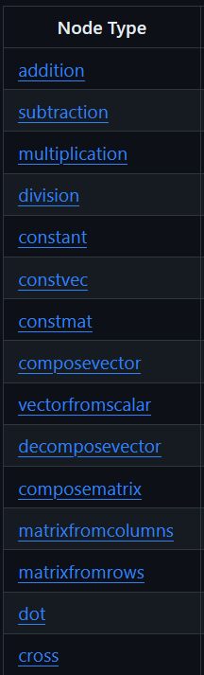
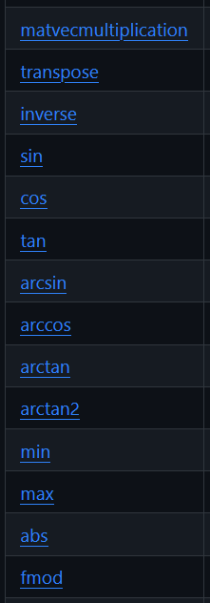
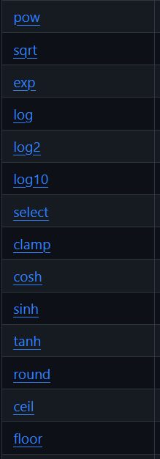
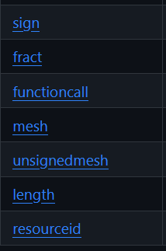
Builtin nodes
https://github.com/3MFConsortium/spec_volumetric/blob/implicit/3MF%20Volumetric%20Extension.md#chapter-4-native-nodes
No higher nodes e.g. for primitives (box, sphere, gyroid etc.)
-> To be defined as functions by combining nodes by the producer

Slide 21
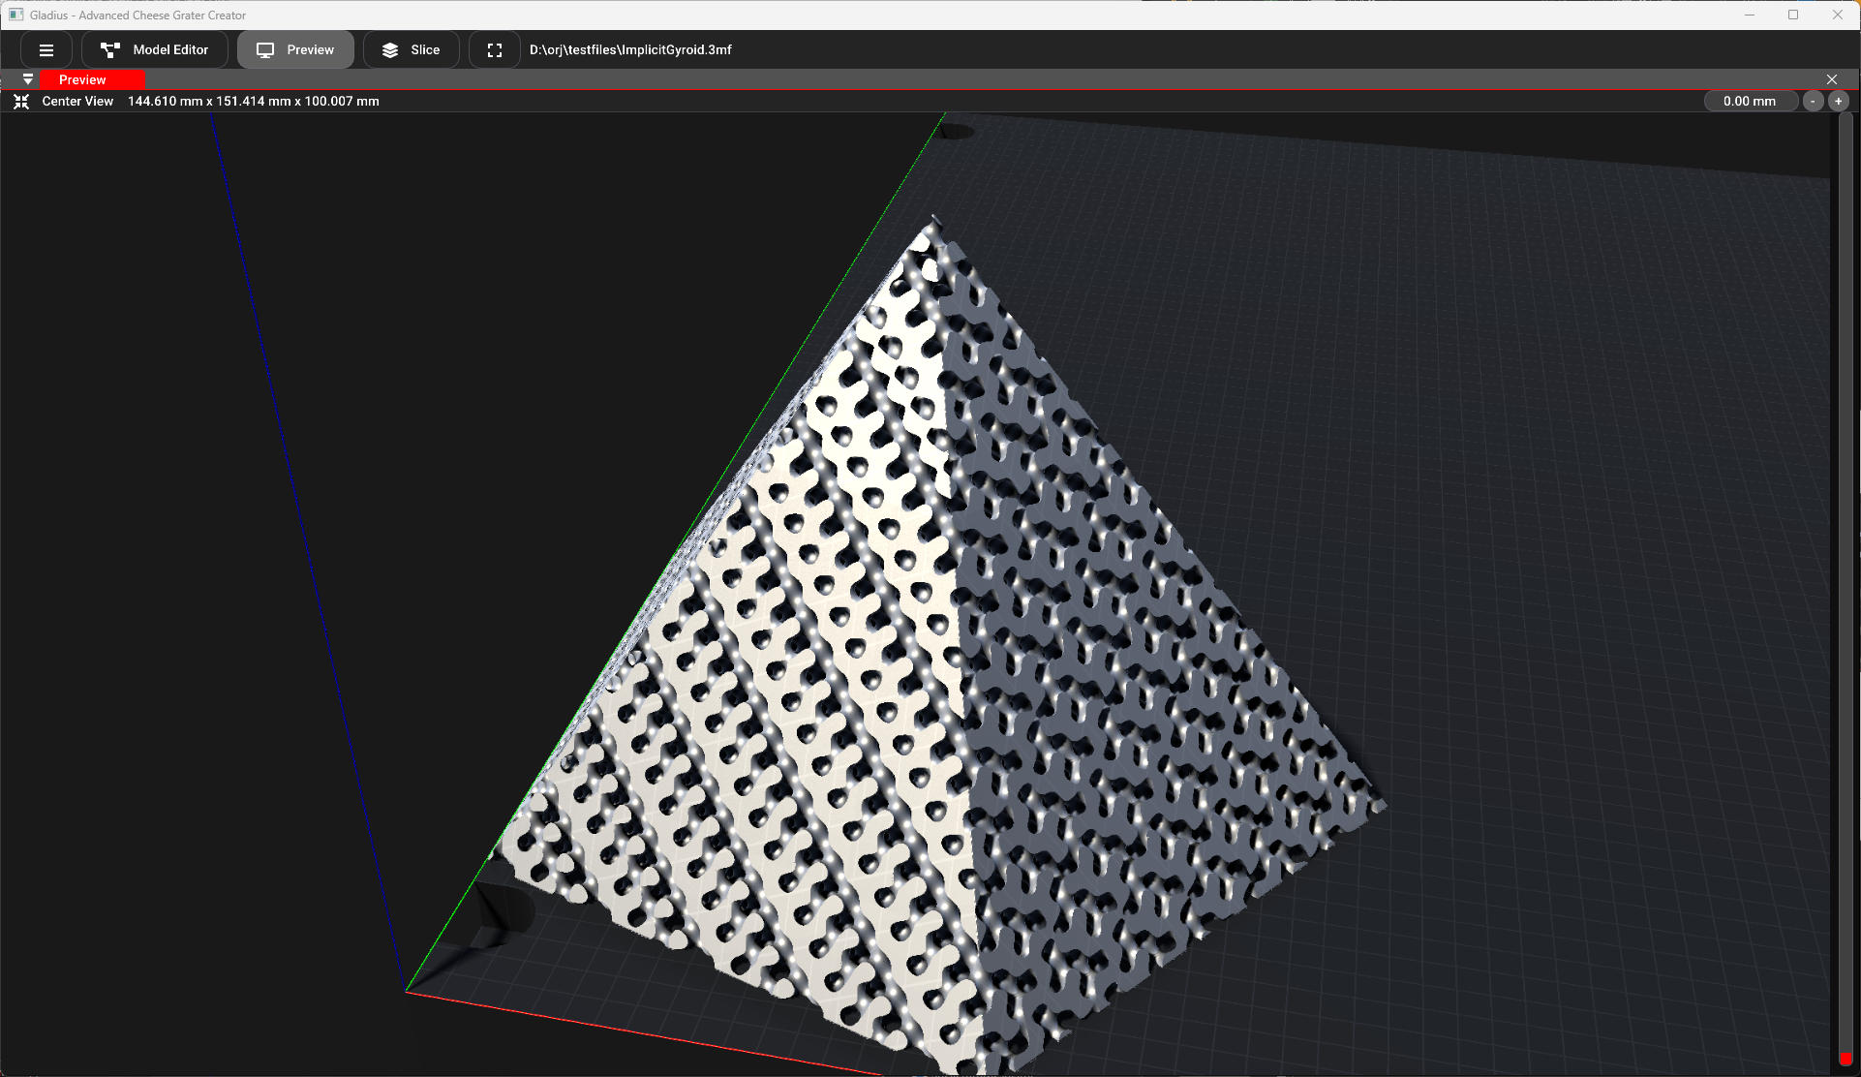
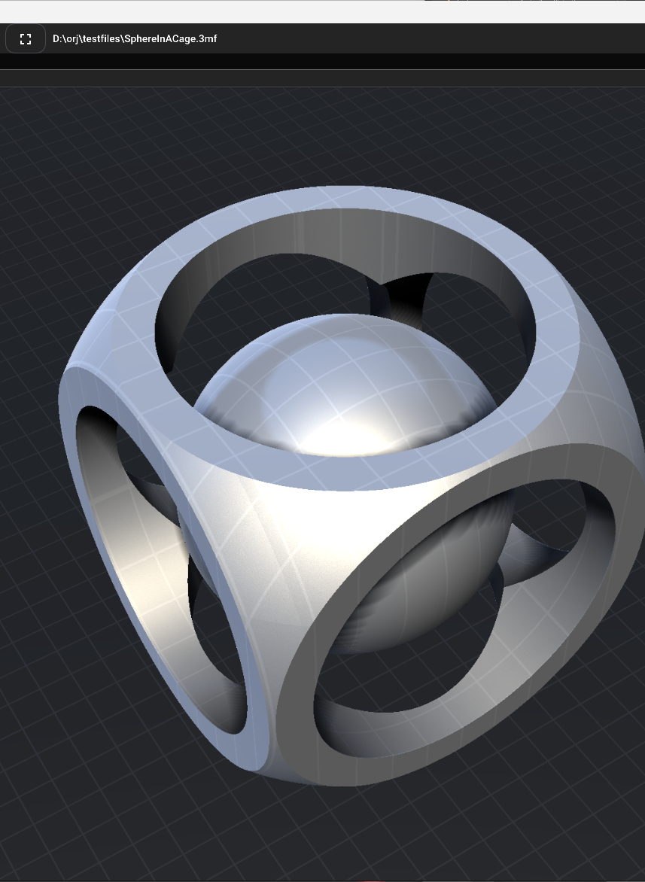
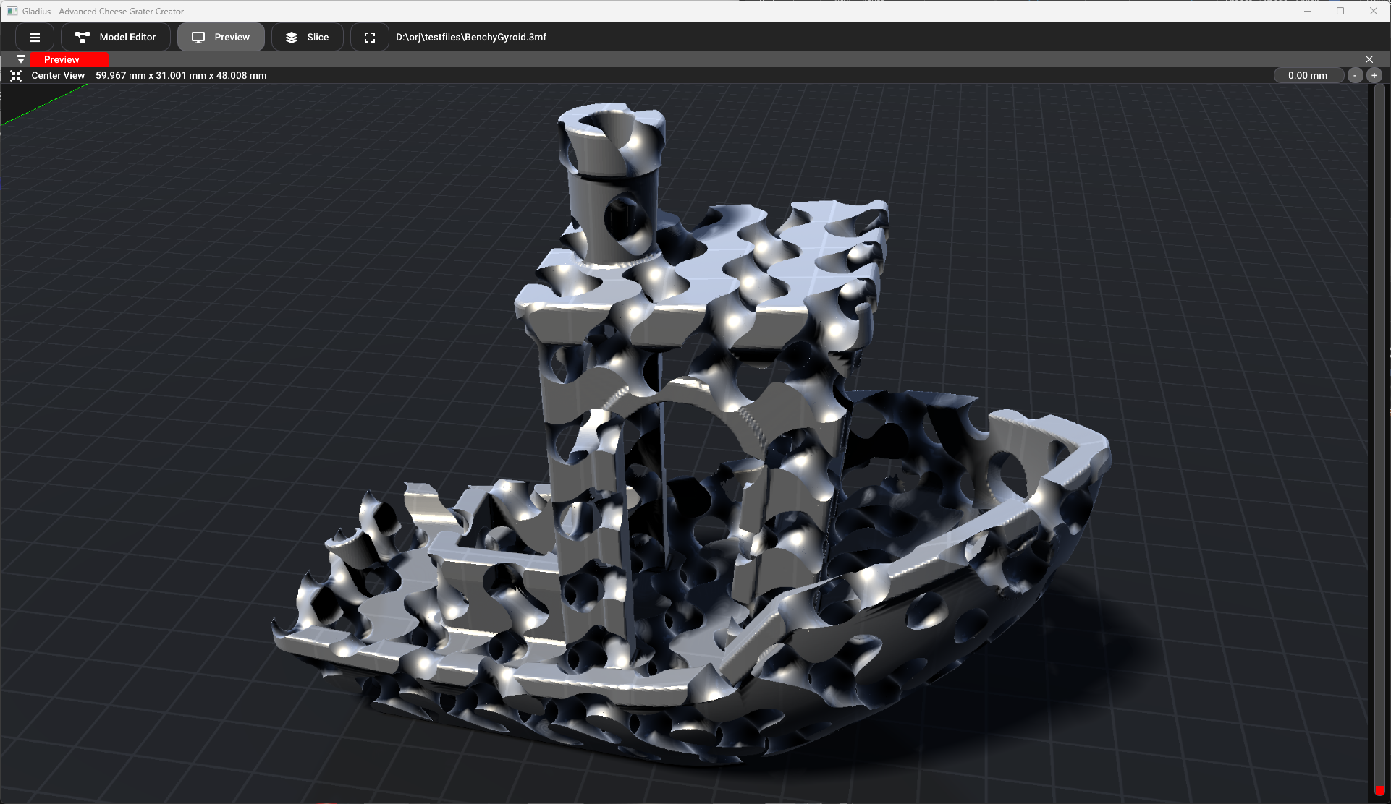
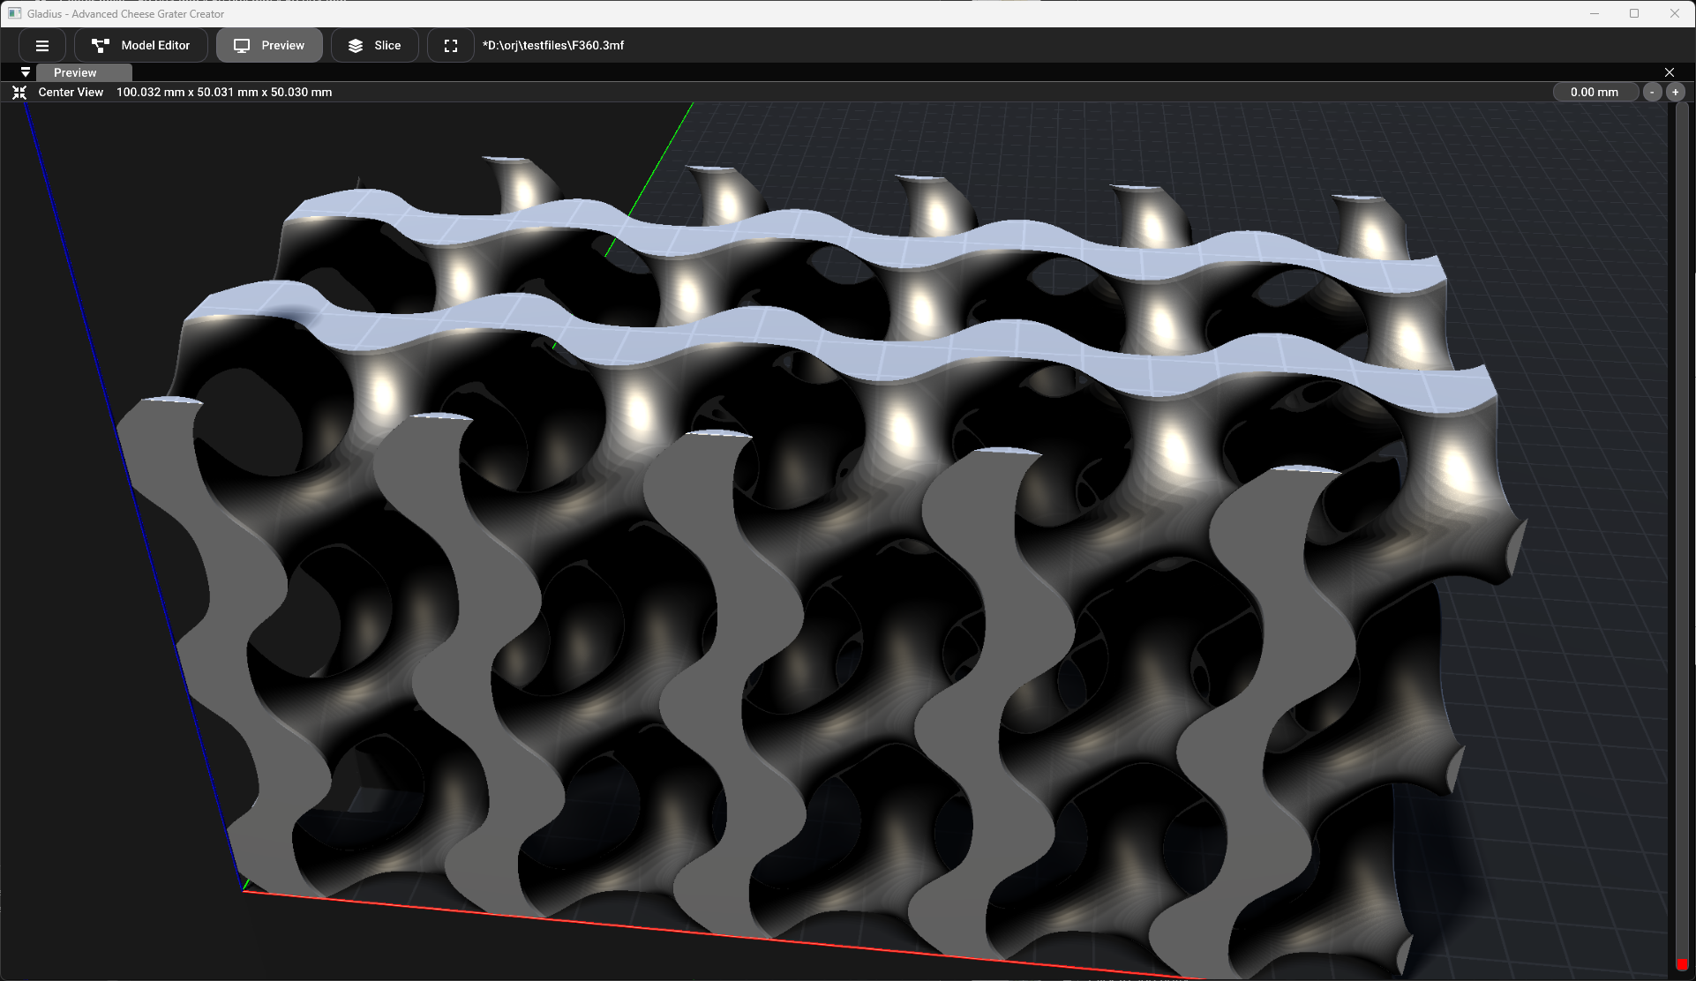
Examples

Slide 22
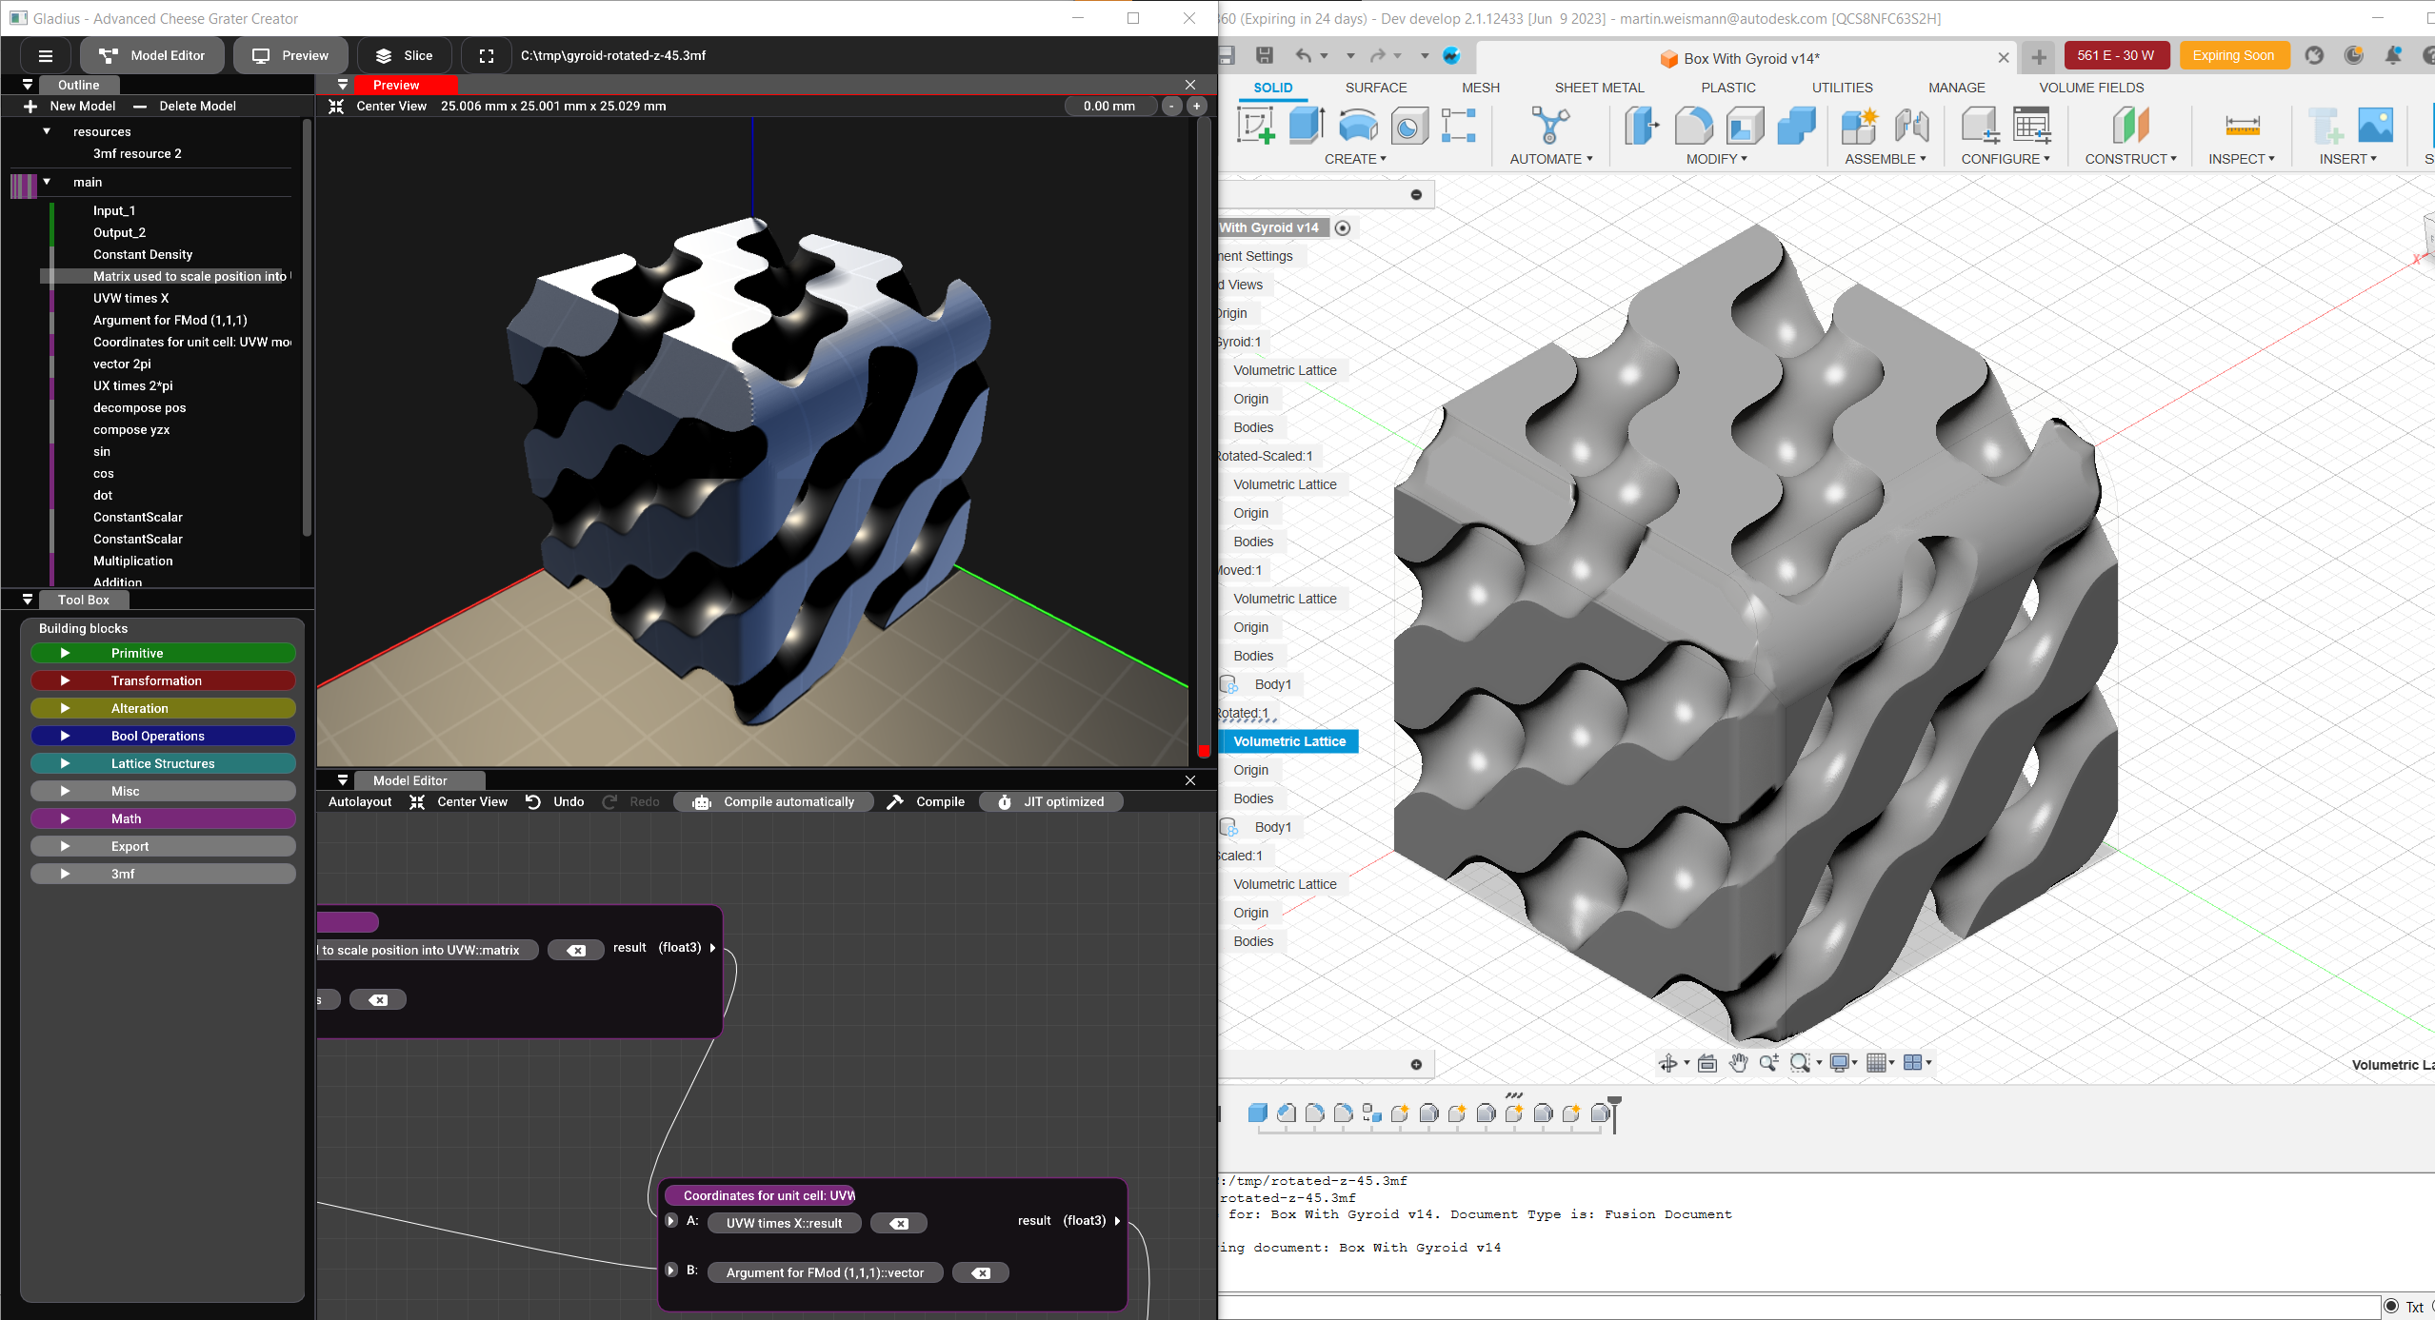
gyroid-rotated-z-45.3mf
To be replaced

Slide 23
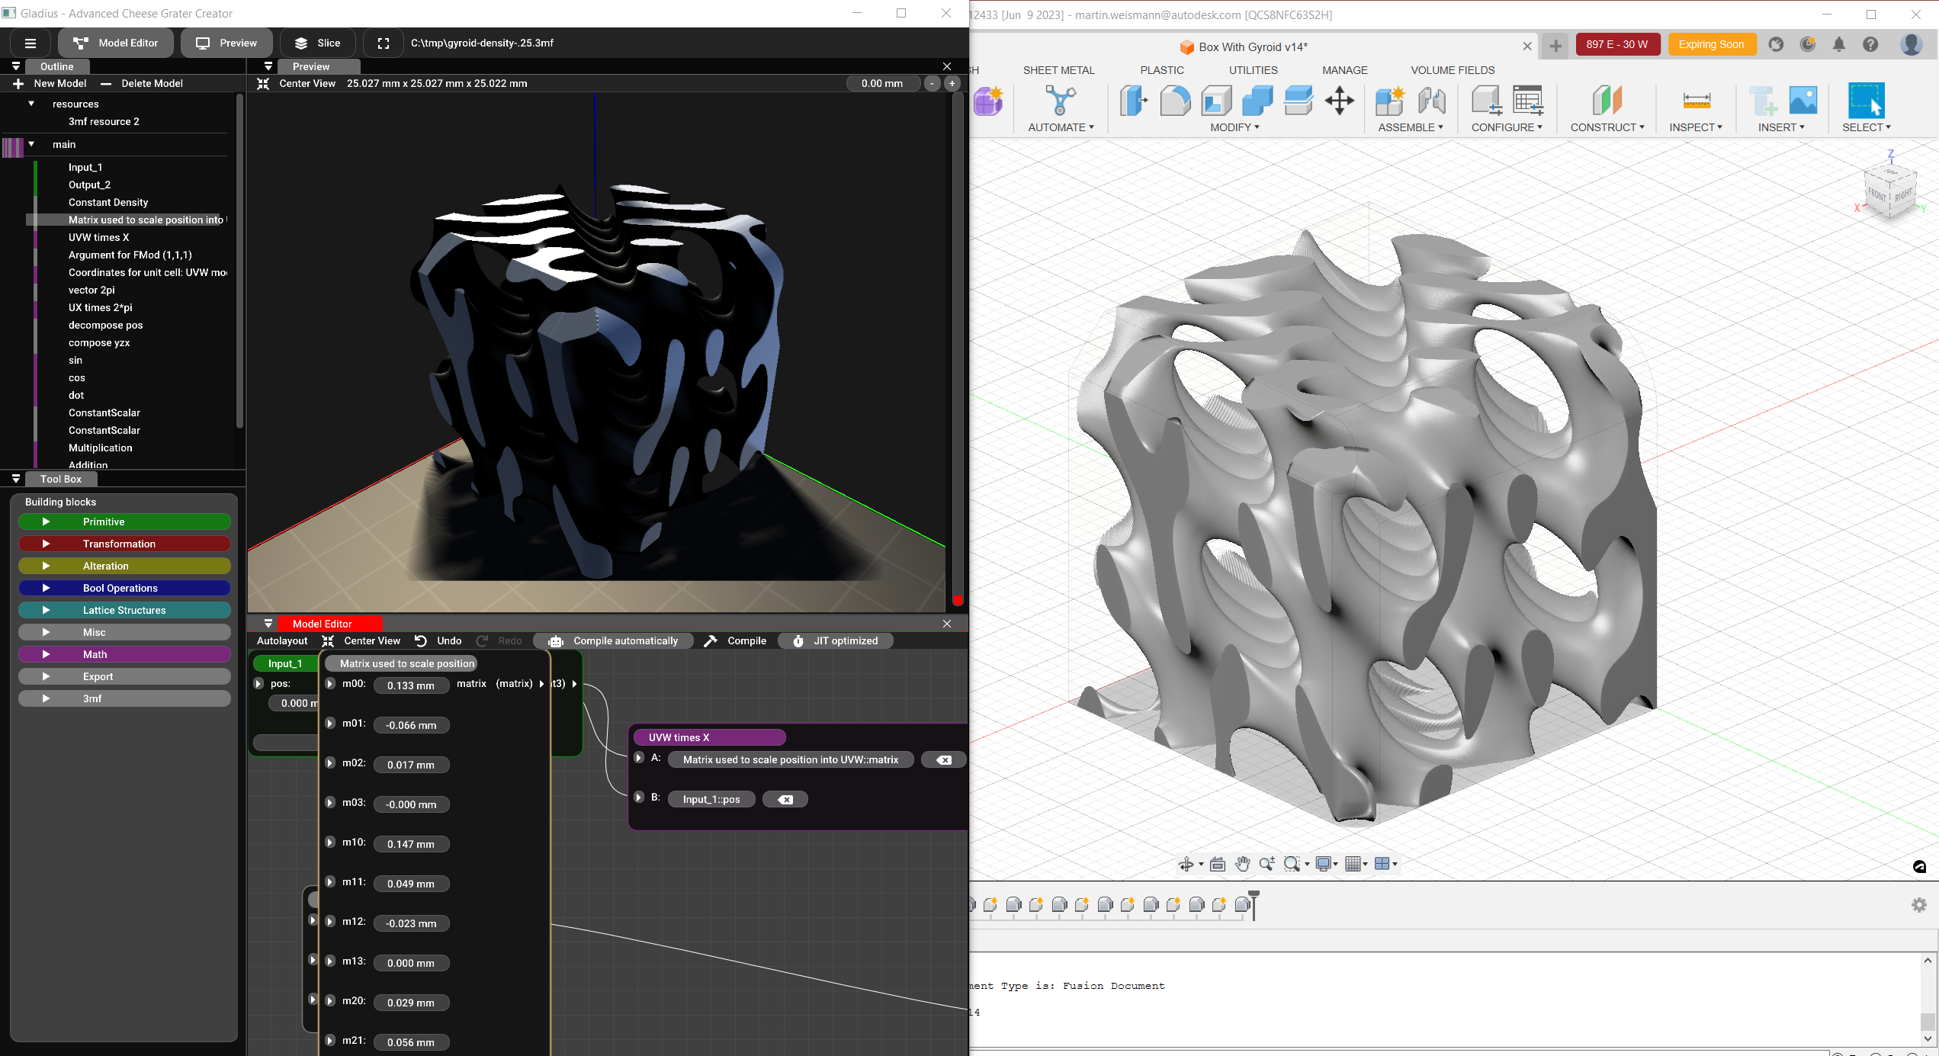
gyroid-density-.25.3mf
To be replaced

Slide 24
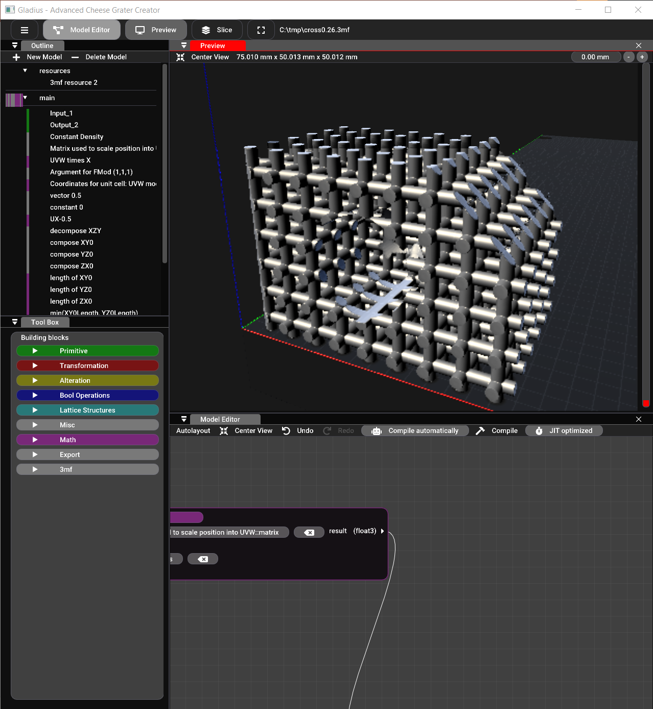
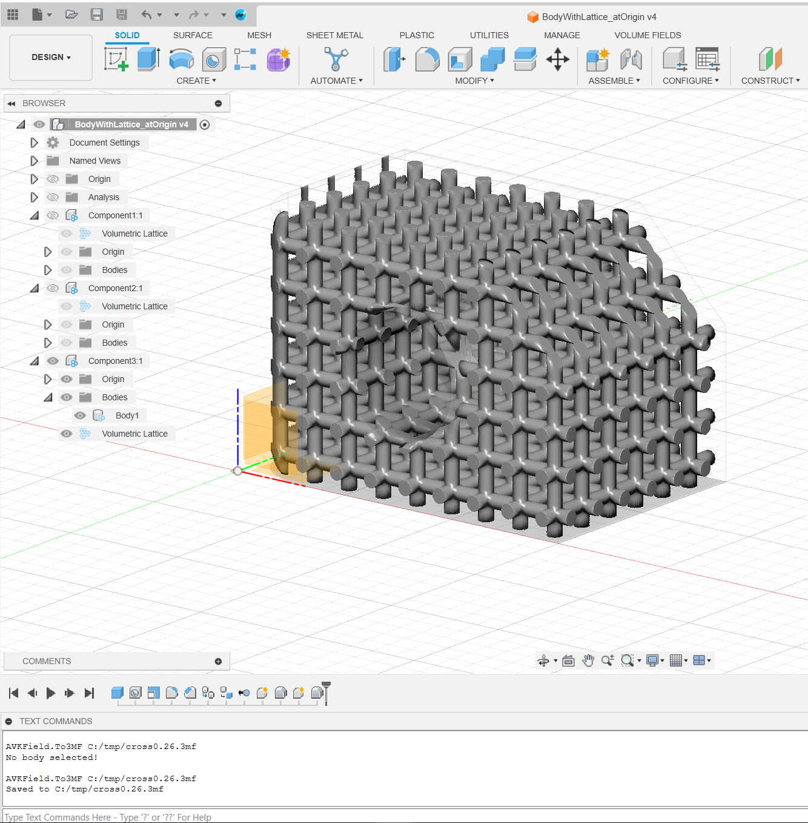
To be replaced

Slide 25
Backup

Slide 26
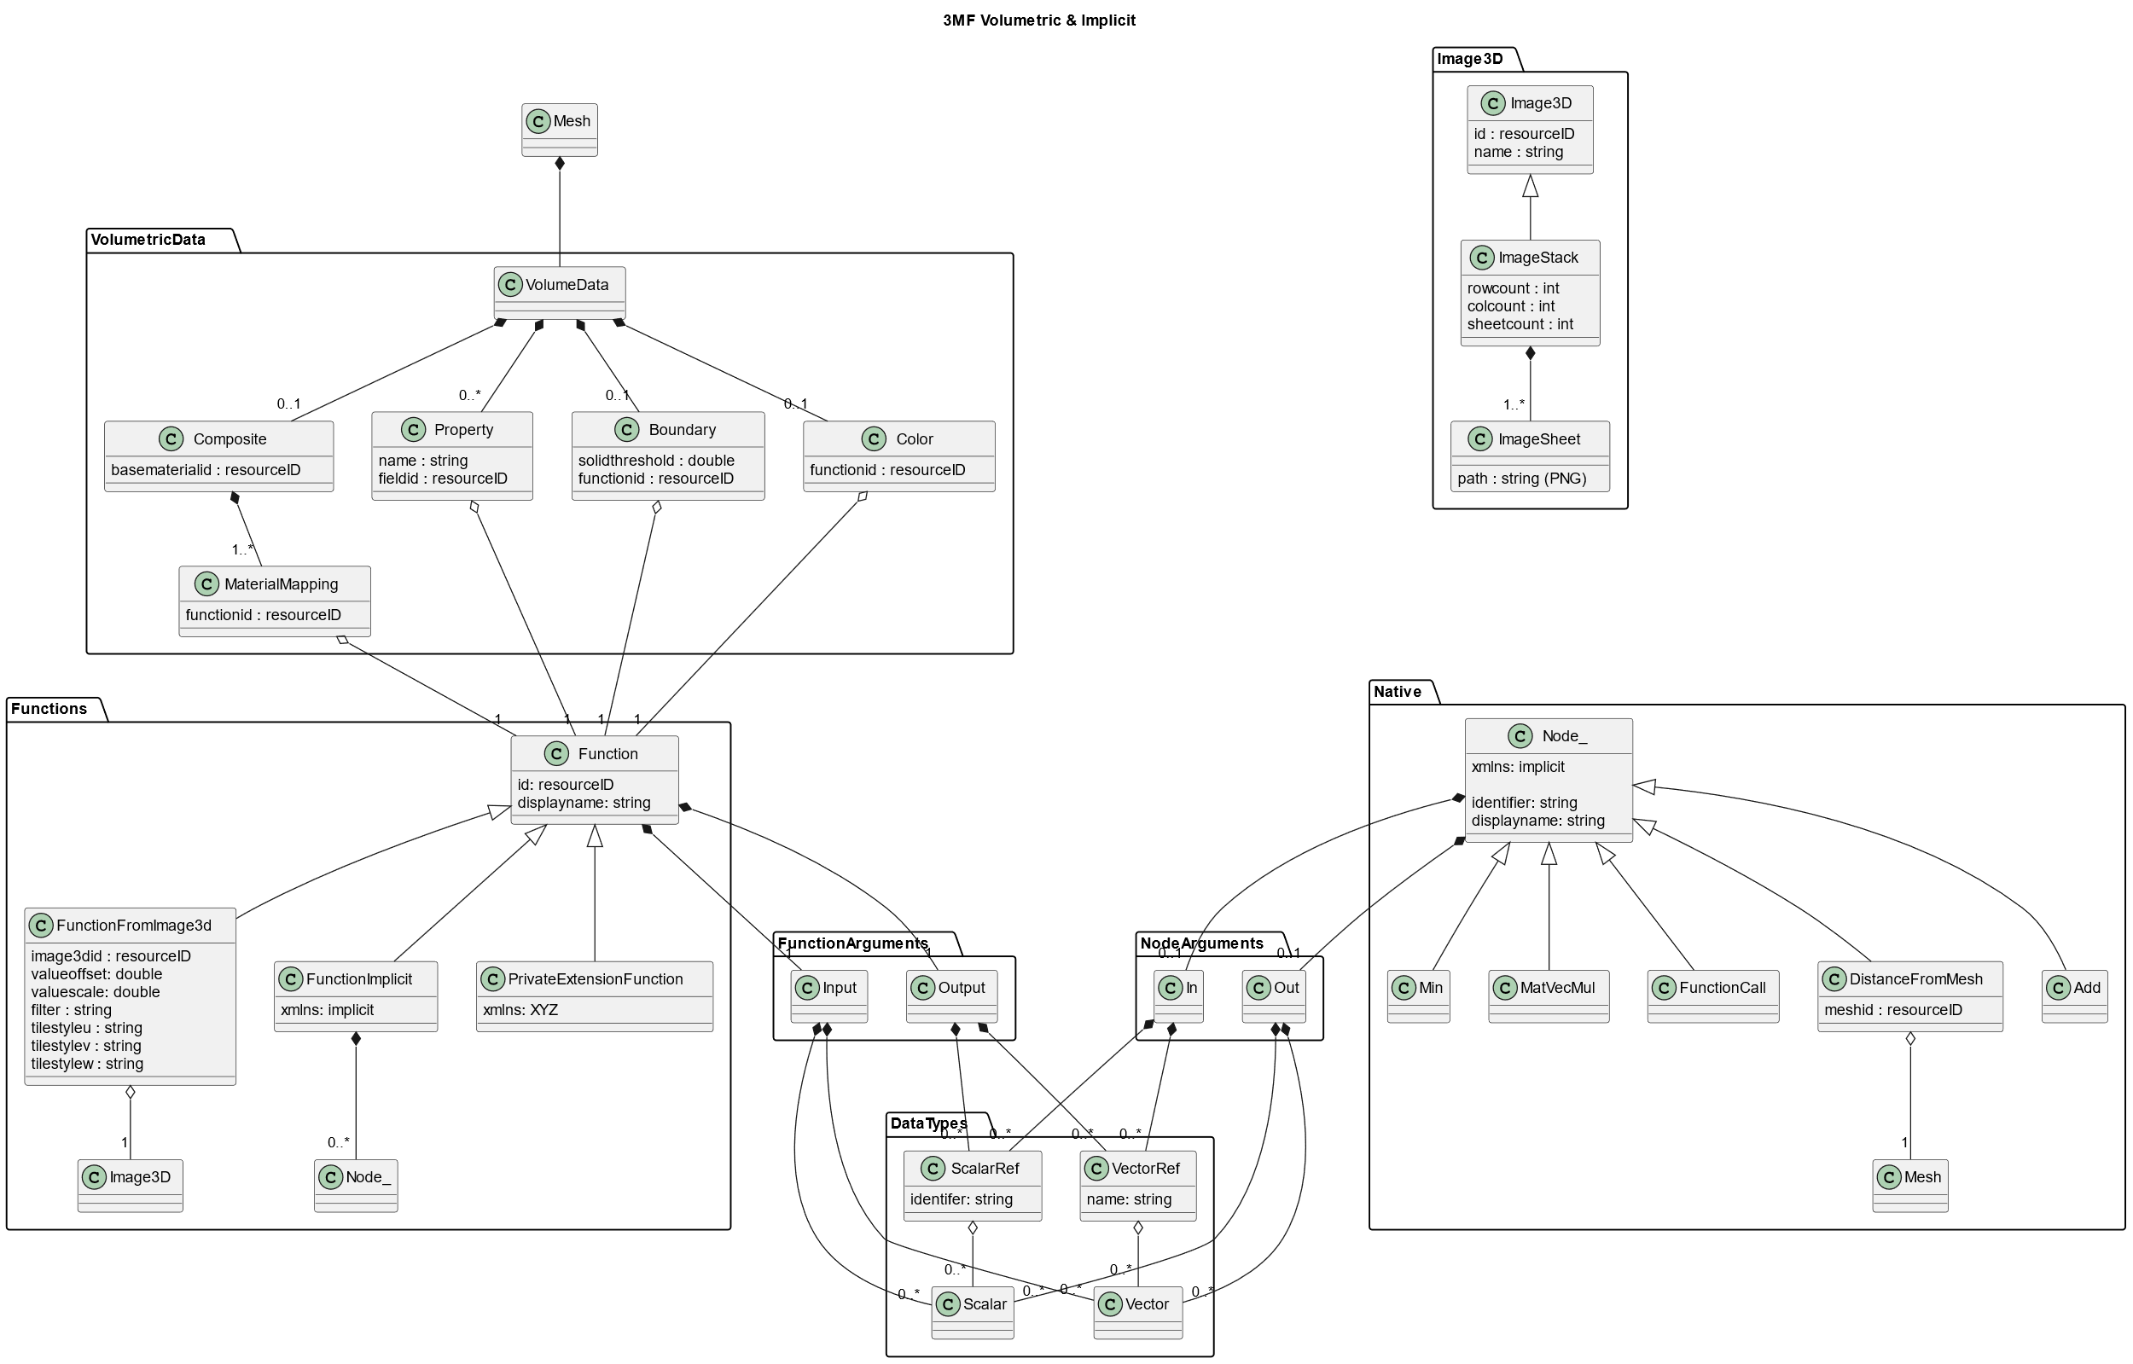
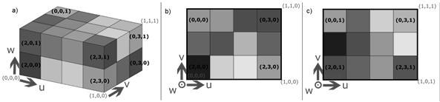
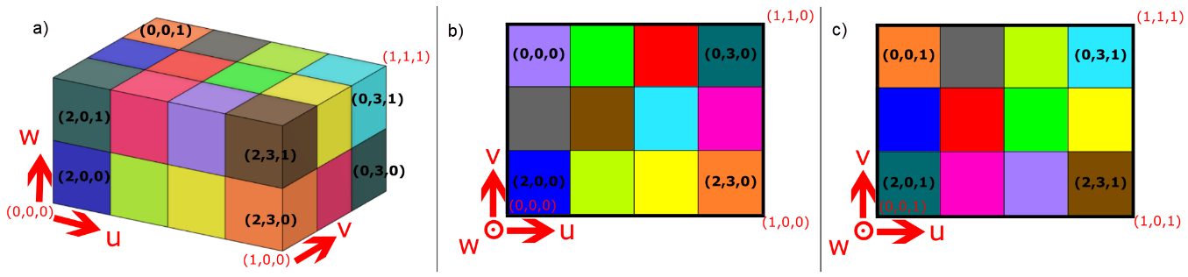
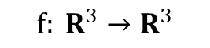
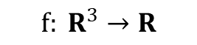
3D Textures as Voxel grids
implemented as a stack of PNG files
greyscale
$$f: R^{3}→R$$
or RGB
$$f: R^{3}→R^{3}$$

Slide 27
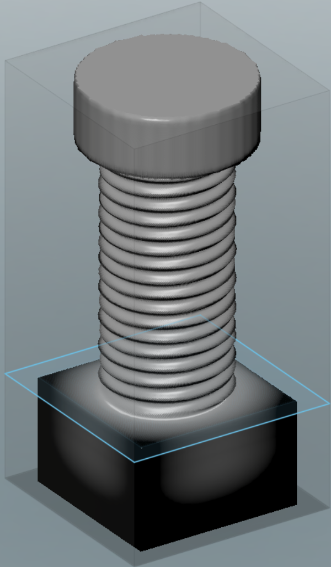
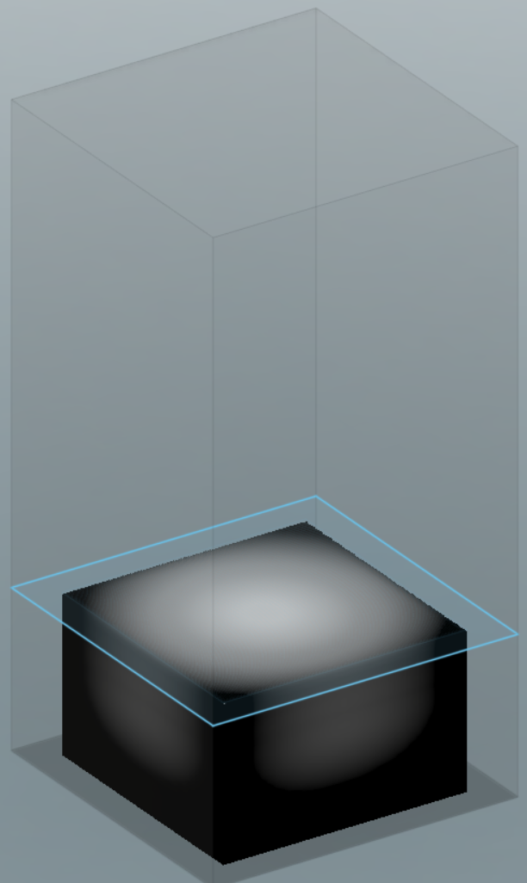
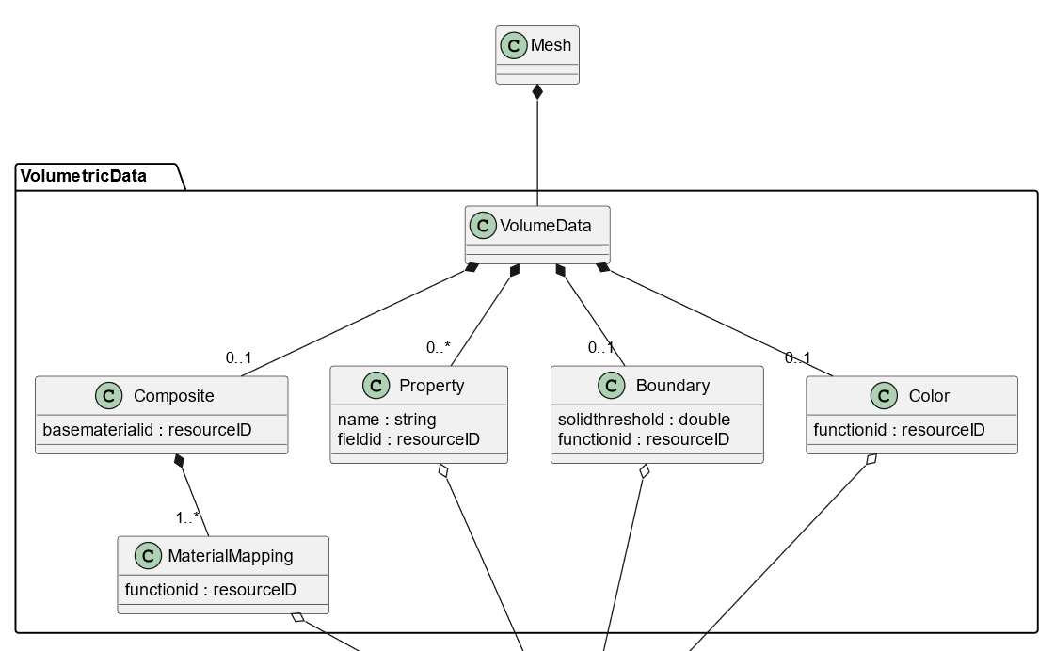
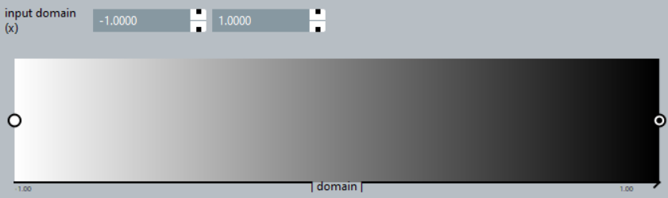
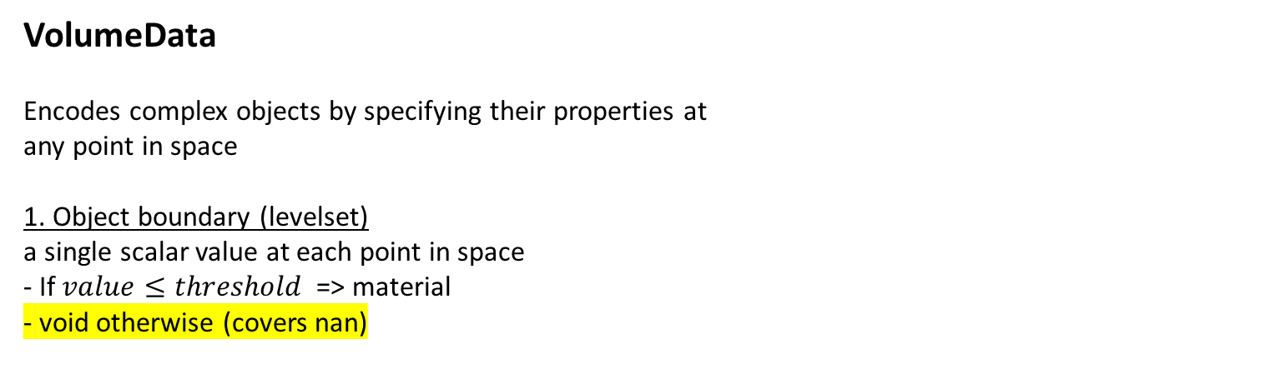
Which information should we encode
VolumeData
Encodes complex objects by specifying their properties at any point in space
1. Object boundary (levelset) a single scalar value at each point in space - If $value≤threshold$ => material - void otherwise (covers nan)
-1
0
1

Slide 28
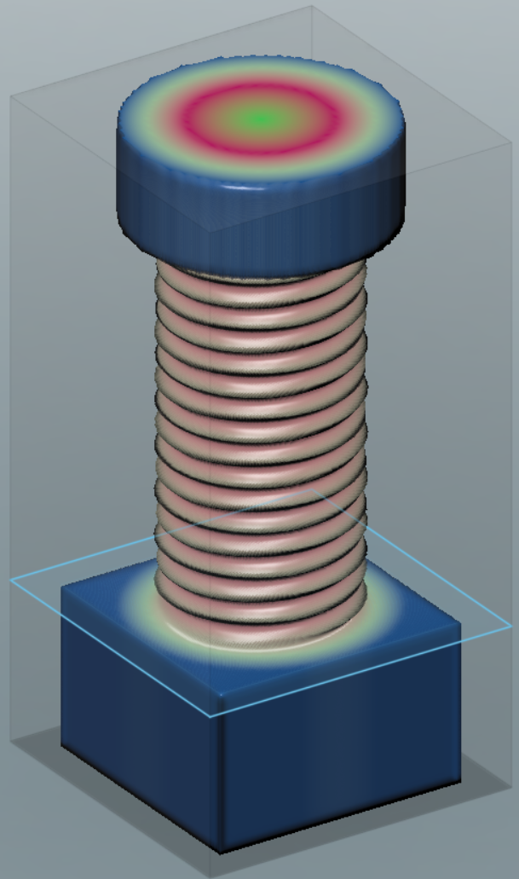
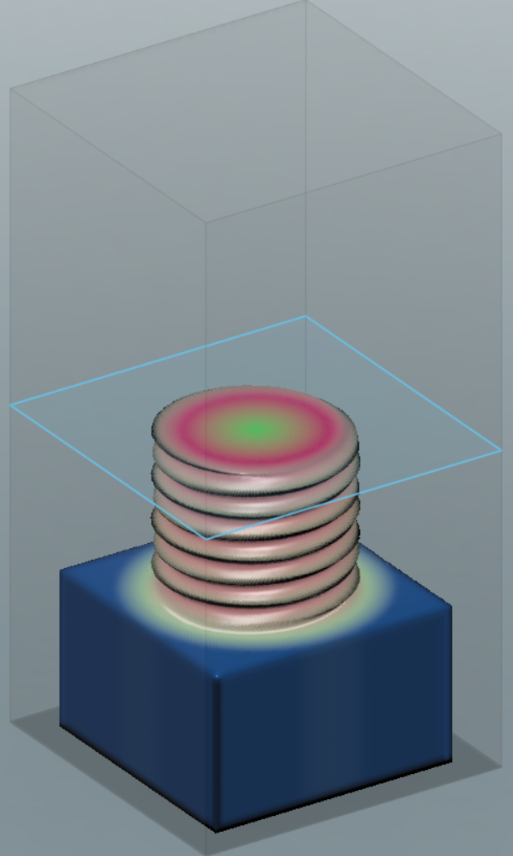
Which information should we encode
VolumeData
Encodes complex objects by specifying their properties at any point in space
2. Spatially varying Color A triplet of color values (R, G, B) between 0 and 1 at each point in space

Slide 29
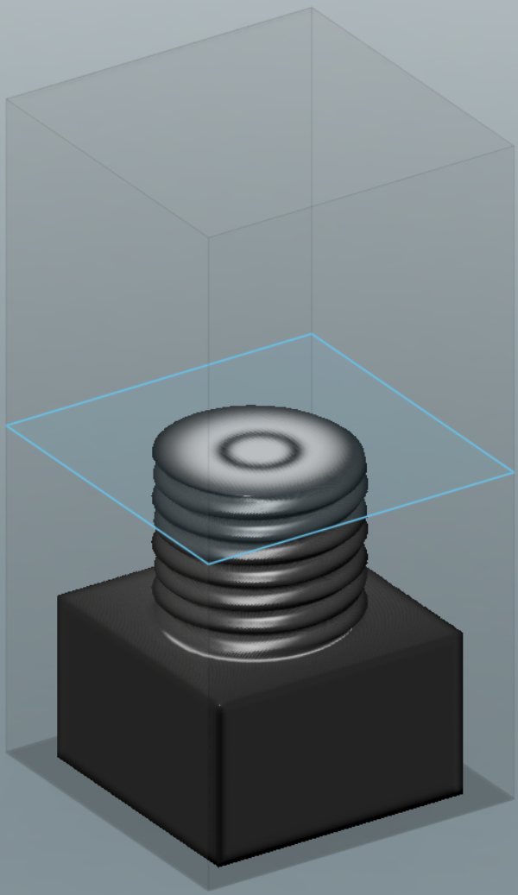
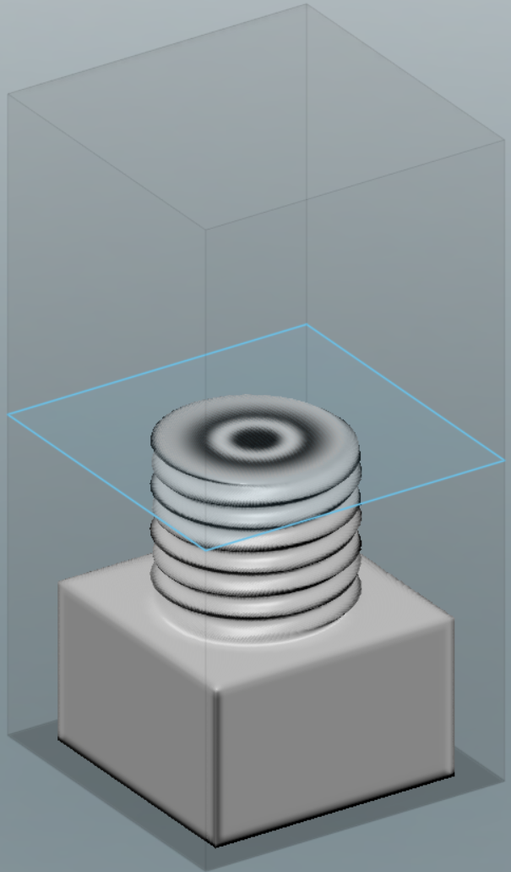
Which information should we encode
VolumeData
Encodes complex objects by specifying their properties at any point in space
3. Material composition: - multiple scalar functions with intensities between [0,1] - each associated with a basematerial - mixing according to their intensity
Contribution “Material 1”
Contribution “Material 2”
0
0.5
1

Slide 30
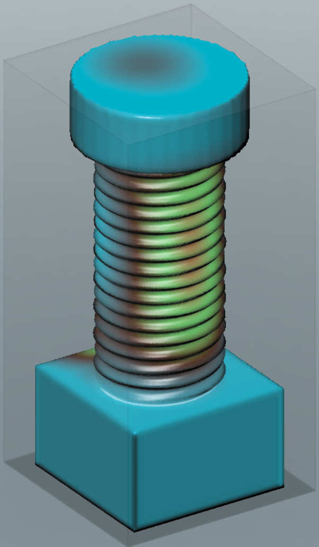
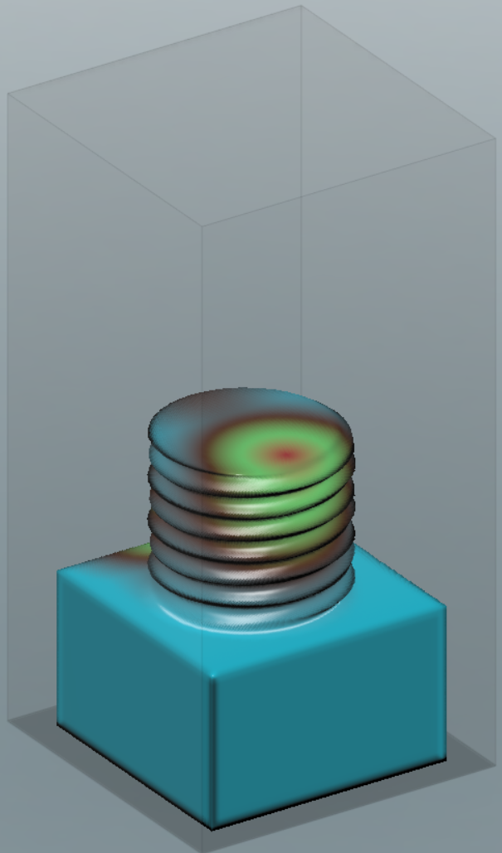
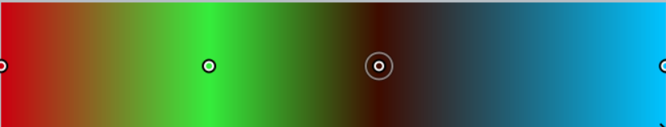
Which information should we encode
VolumeData
Encodes complex objects by specifying their properties at any point in space
4. High level (arbitrary) properties: - Single function with scalar or vector-valued intensity/value - Encode intensity of an abstract property: (“conductivity”, “density”, “durometer”, …) - Consumer can decide, how to achieve that property
0
0.5
1

